Slide 1


Modeling Business Investment Attractiveness of Countries Using Time Series Approaches
Accenture Industry Mentor:
Pramanik Paritosh (paritosh.pramanik@accenture.com)
Authors:
Di Mu (dm3686@Columbia.edu)
Freddy Wong (ww2615@Columbia.edu)
Hanlin Yan (ww2615@Columbia.edu)
Jace Yang (jy3174@Columbia.edu)
Yuan Heng (yh3416@Columbia.edu)
GitHub Repository: HannahFromAland/Accenture4-Evaluating-the-Attractiveness-of-a-Country
Columbia MSDS Fall 2022 Capstone Presentation
Notes:
Before everything, I want to clarify that it is not a very Self-contain slides and some teammates are not here,so I might need to refer to the final report to answer the question
So, please bear with me with that.

Slide 2
Executive summary
Goal
Use ML/DL time series techniques to turn country investment attractiveness evaluation into a modeling pipeline.
Identify opportunities from structural transformation of sectors in economy globally in future 5 years.
Solution Approach
In this project, we carefully examinate toolkits for infrequent aggregated time series with severe missing value issue.
Target Manufacturing and Service value added as a percentage of GDP of 9 countries, modeling it with indictors carefully selected from World Bank Open Data.
Multiple imputation techniques are experimented and combined to deal with over 50% missingness
Stack 8 models to predict into future 5 years(2022-2026).
Result Delivered
Based on predictions on the countries we selected, Singapore is the best for service sector investment for a 3.1% of GDP increase and China best for manufacturing for a 1.6% of GDP increase in the future 5 years.
Notes:
The result we present to potential shareholder at the very end, is that we believe.
To make such conclusion

Slide 3

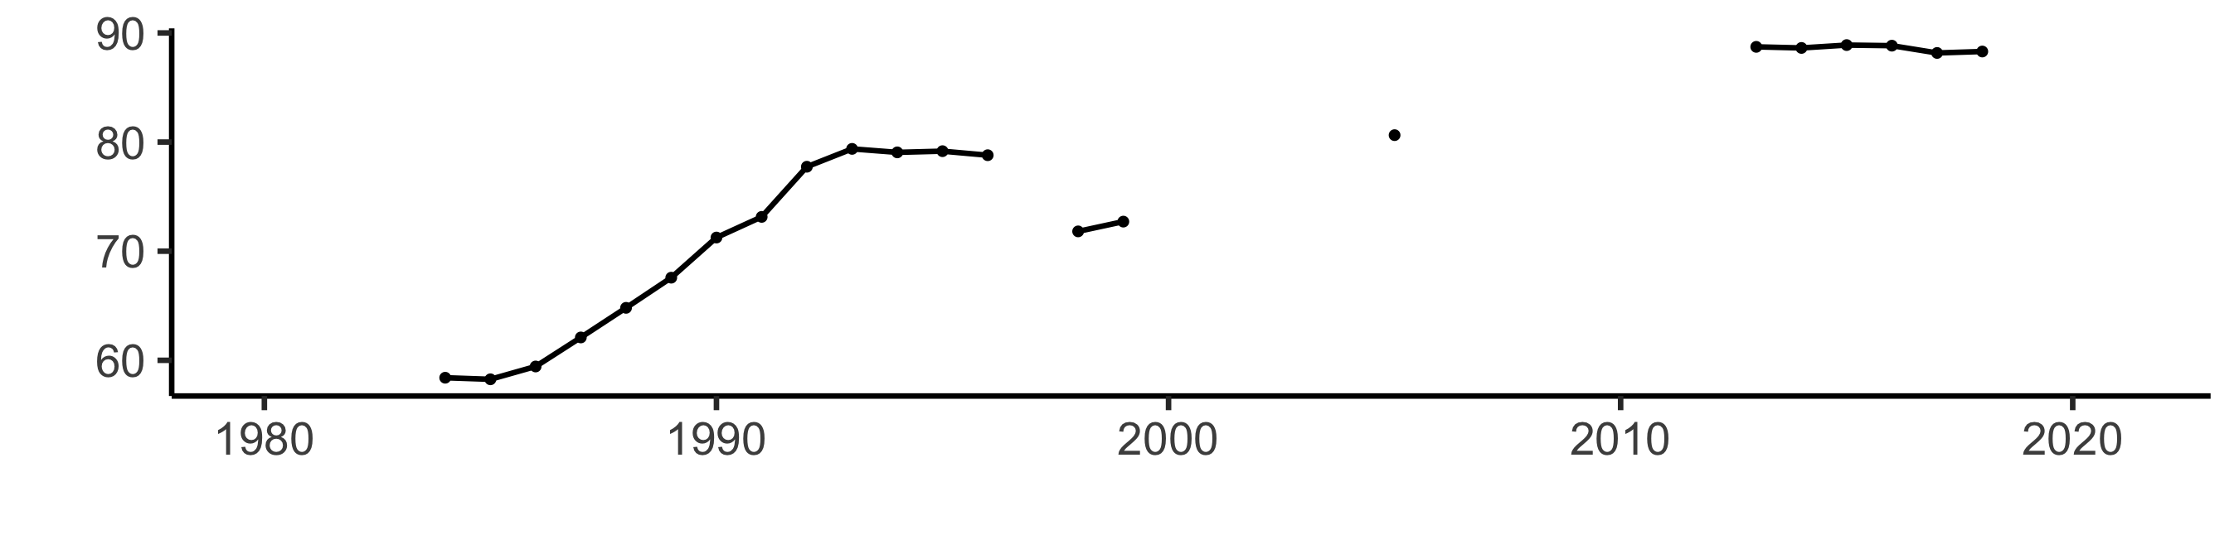
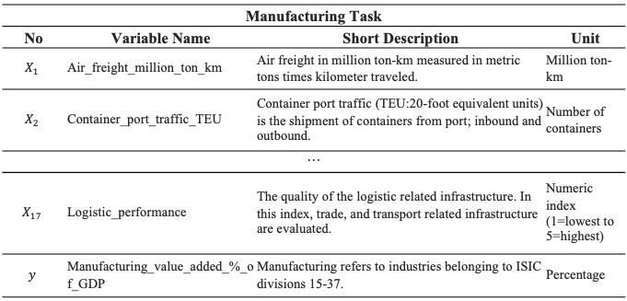
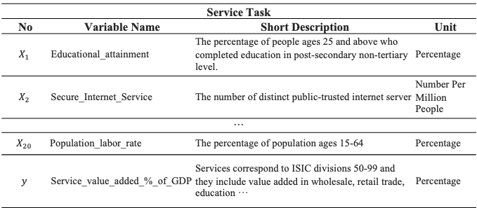

Data Preprocessing >> Model Developing & Evaluating >> Model Deployment & Prediction
To obtain model-ready datasets, we consolidate and clean features for 9 countries in several steps.
2 tasks
Manufacturing
Service
Features considered in two tasks
Row Deletion
Applied for missing value of $y$ before first available observation of $y$
Manufacturing Task
No | Variable Name | Short Description | Unit
$$X_{1}$$ | Air_freight_million_ton_km | Air freight in million ton-km measured in metric tons times kilometer traveled. | Million ton-km
$$X_{2}$$ | Container_port_traffic_TEU | Container port traffic (TEU:20-foot equivalent units) is the shipment of containers from port; inbound and outbound. | Number of containers
···
$$X_{17}$$ | Logistic_performance | The quality of the logistic related infrastructure. In this index, trade, and transport related infrastructure are evaluated. | Numeric index (1=lowest to 5=highest)
$$y$$ | Manufacturing_value_added_%_of_GDP | Manufacturing refers to industries belonging to ISIC divisions 15-37. | Percentage
✖️
10+ features
17 for manufacturing
20 for service are carefully selected from 200+ World Bank predictors based on literature review & correlation test
Imputation
Use NOCB and Spline to impute, based on experiments upon a baseline LSTM model with lots of combinations of available imputation techniques:
Last Observation Carried Forward (LOCF)
Next Observation Carried Backward (NOCB)
Rolling Statistics
Linear / Spline Interpolation (trimmed)
Weighted/Exponential Moving Average
✖️
9 Countries
AUS, BRA, CAN
CHN, GBR, IND
JPN, SGP, USA
Service Task
No | Variable Name | Short Description | Unit
$$X_{1}$$ | Educational_attainment | The percentage of people ages 25 and above who completed education in post-secondary non-tertiary level. | Percentage
$$X_{2}$$ | Secure_Internet_Service | The number of distinct public-trusted internet server | Number Per Million People
···
$$X_{20}$$ | Population_labor_rate | The percentage of population ages 15-64 | Percentage
$$y$$ | Service_value_added_%_of_GDP | Services correspond to ISIC divisions 50-99 and they include value added in wholesale, retail trade, education ··· | Percentage
NOCB
Univariate Spline
✖️
Column Deletion
Country-task-specific: imputation rate over a pre-determined threshold
Model-specific: VAR requires stationary
30 years of data points
From 1980 or earliest available data for the country to 2021
Granger Causality Test
Notes:
. I will introduce how we consolidate data, model it and make prediction

Slide 4
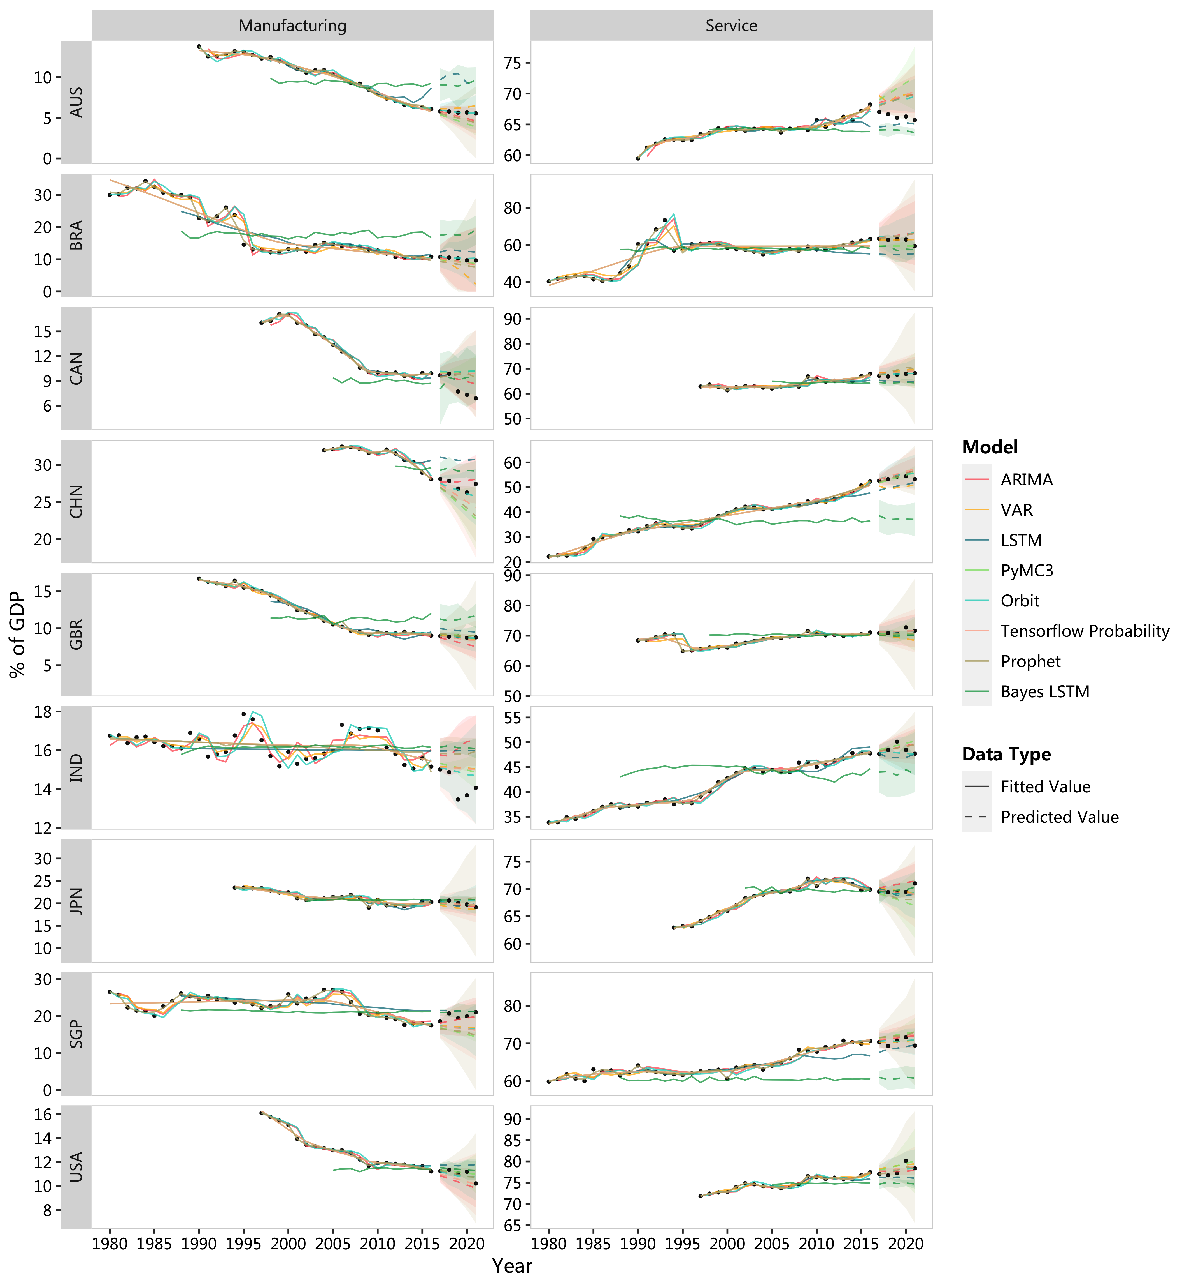
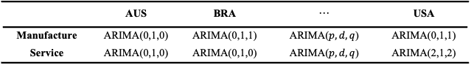
Data Preprocessing >> Model Developing & Evaluating >> Model Deployment & Prediction
Carefully examinate toolkits to model infrequent aggregated time series
Keep 8 candidate models after experiments:
Each of model is trained on a task-country-wise granularity. For example:
Evaluating on test set (2017-2021), univariate Bayes model performs better in most cases.
 | AUS | BRA | ··· | USA
Manufacture | ARIMA(0,1,0) | ARIMA(0,1,1) | ARIMA($p, d, q$) | ARIMA(0,1,1)
Service | ARIMA(0,1,0) | ARIMA(0,1,0) | ARIMA($p, d, q$) | ARIMA(2,1,2)
Development Set
Test
Development Set
Test
Notes:
ARIMA(Autoregressive integrated moving average)
Vector Autoregression (VAR), also Granger-Causality Test
LSTM three-dimensional tensor, representing (Batch Size, Input Width, and Number of features). The input width represents the number of years each LSTM cell looks back to make the forecast. This is a hyperparameter that we have tuned. Four years is the best input width. The number of features is the number of features the model takes as an input. Since the goal of the project is to forecast the manufacturing and service industries' attractiveness in the following five years, the output tensor is in the dimension of (Batch Size, 5).
Bayes Blundell et al. in their paper "Weight Uncertainty in Neural Networks" introduced an algorithm for learning a probability distribution on the weights of a neural network, called Bayes by Backprop (BBB), which only requires a minor modification to the backpropagation algorithm.[26] This is the so-called Bayes LSTM. Bayes LSTM is trying to create a confidence interval (CI) when making predictions.
Prophet is a Facebook-created method for forecasting time series data based on an additive model with yearly, weekly, and daily seasonality as well as holiday effects.
Orbit is a Python package for Bayesian time series modeling and inference. It provides a familiar and intuitive initialize-fit-predict interface for working with time series tasks, while utilizing probabilistic programming languages under the hood.
PyMC3 is a Python package for Bayesian statistical modeling focusing on advanced Markov chain Monte Carlo (MCMC) and variational inference (VI) algorithms. In our practice, we model a piecewise constant growth with changepoints
Tensorflow probability is a library built on TensorFlow that makes it easier to utilize probabilistic models and deep learning, allowing users to build and train complex models that can handle uncertainty and make predictions based on probabilistic assumptions.

Slide 5
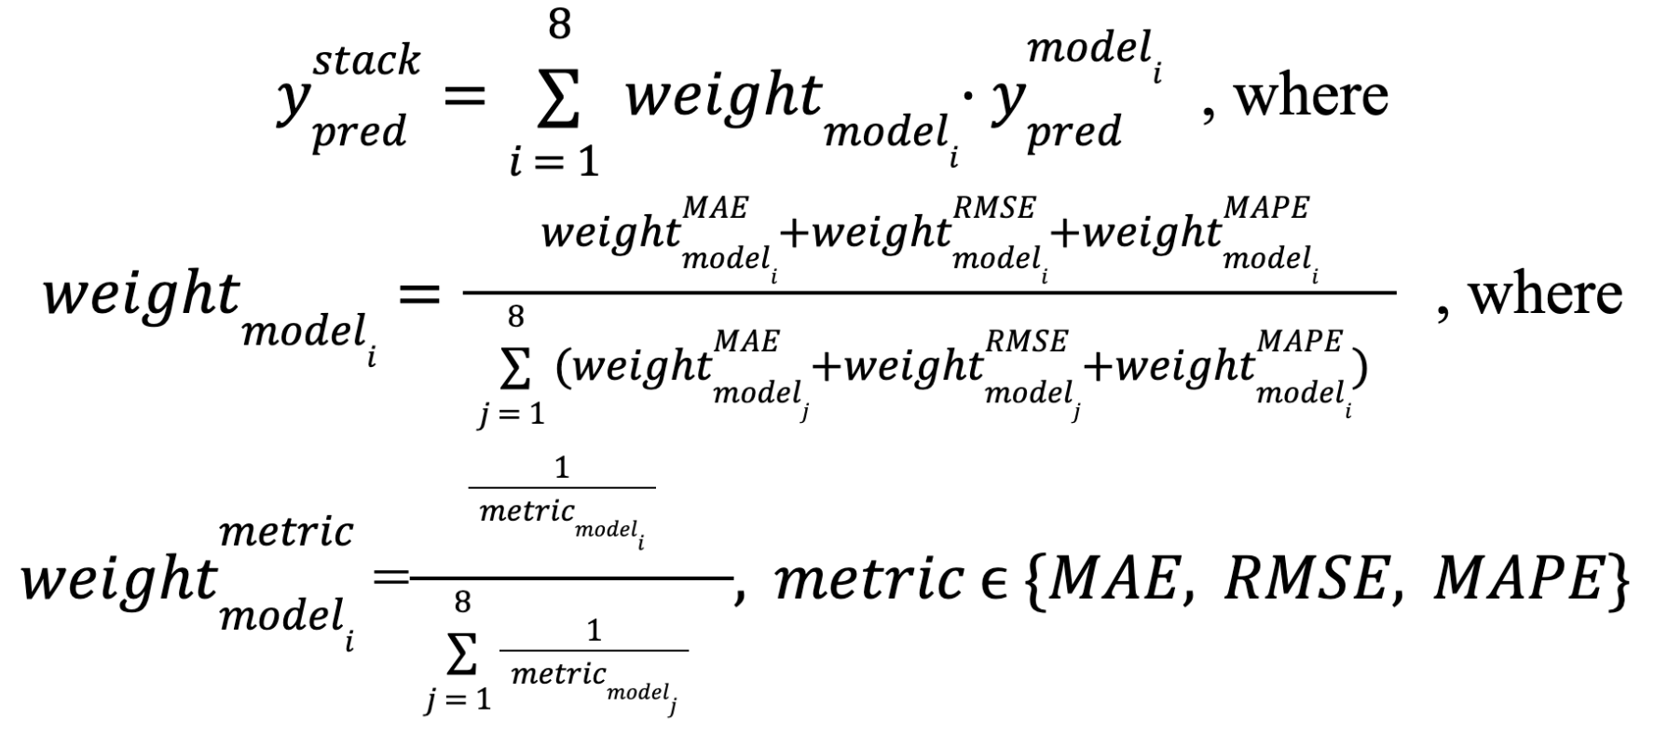
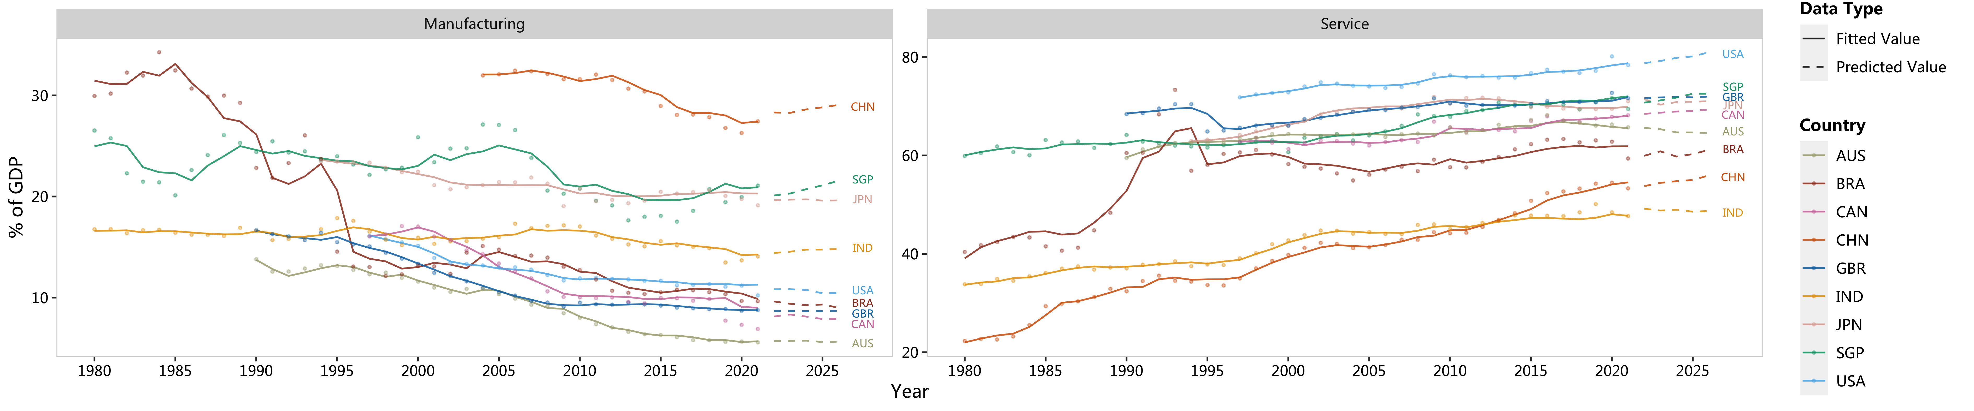
Data Preprocessing >> Model Developing & Evaluating >> Model Deployment & Prediction
We implement an innovative ensemble to utilize all model & data to predict
To make final prediction, we re-trained all models in the entire dataset and stack them country-task-wisely weighted on their performance, which is equally defined by $\frac{1}{MAE}$, $\frac{1}{RMSE}$, and $\frac{1}{MAPE}.$
Notes:
soft max on different metric

Slide 6
Q&A
Modeling Business Investment Attractiveness of Countries Using Time Series Approaches
Accenture Industry Mentor:
Pramanik Paritosh (paritosh.pramanik@accenture.com)
Authors:
Di Mu (dm3686@Columbia.edu)
Freddy Wong (ww2615@Columbia.edu)
Hanlin Yan (ww2615@Columbia.edu)
Jace Yang (jy3174@Columbia.edu)
Yuan Heng (yh3416@Columbia.edu)
GitHub Repository: HannahFromAland/Accenture4-Evaluating-the-Attractiveness-of-a-Country
Columbia MSDS Fall 2022 Capstone Presentation

